Slide 1
Project Title: Restaurant Analysis of Swiggy Using PowerBI
Cap Stone Project
Prepared by
Tharuna
MBE8

Slide 2
Skills Takeaway from This Project:
- Data Cleaning and Preprocessing
- Data Visualization with Power BI
- Data Analysis and Interpretation
- Creating Interactive Dashboards
- Understanding Key Business Metrics in the Food Delivery Industry
Domain:
Food Delivery Services
Problem Statement:
The aim is to analyze and visualize restaurant data to extract meaningful insights that can help in making informed business decisions. Learners will use Power BI to create interactive dashboards showcasing various aspects of the restaurant's performance.

Slide 3
Business Use Cases:
1. Customer Insights: Understanding customer preferences based on ratings and food types.
2. Operational Efficiency: Analyzing delivery times to improve logistics.
3. Market Positioning: Identifying key areas with high-rated restaurants.
4. Competitive Analysis: Comparing prices and ratings across different restaurants.
5. Decision Support: Providing data-driven recommendations for business growth.
Approach:
1. Data Exploration: Load the dataset into Power BI and explore its structure and content.
2. Data Cleaning: Handle missing values, correct data types, and remove duplicates if any.
3. Data Transformation: Create new columns if necessary (e.g., price range, rating categories).
4. Visualization: Design and create interactive visualizations such as bar charts, pie charts, maps, and tables.
5. Dashboard Creation: Combine visualizations into a cohesive dashboard for easy navigation and insight extraction.
6. Analysis and Insights: Use the dashboard to derive insights and make recommendations.

Slide 4
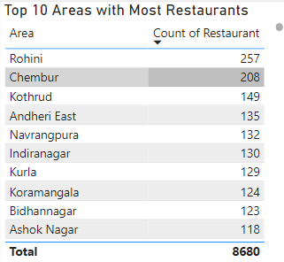
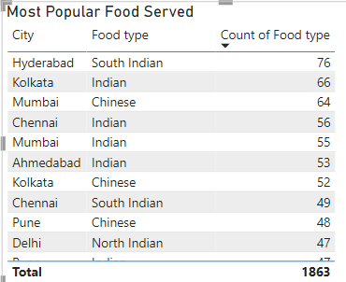
Task List
1. Top 10 Areas with Most Restaurants: Identify the top 10 areas with the highest number of restaurants.
2. Most Popular Food Types Served by Swiggy Restaurants in Each City: Determine the most popular food types served in each city.

Slide 5
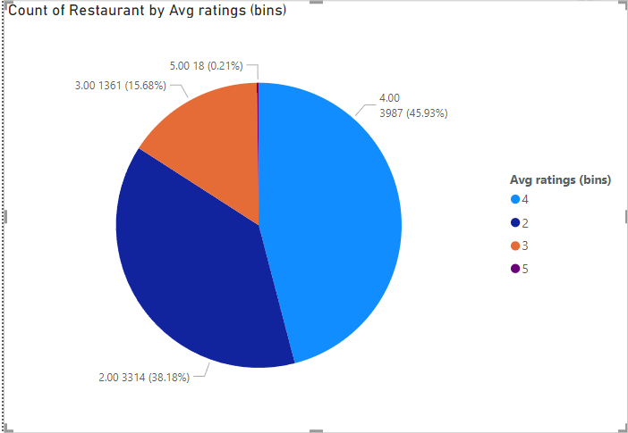
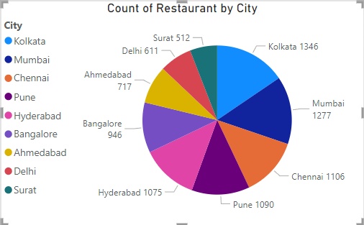
3. Top Rated Swiggy Restaurants (In Percentage): Find the percentage of top-rated restaurants (e.g., those with an average rating above 4.5).
6. City-wise Restaurant Count: Find out the number of restaurants in each city.

Slide 6
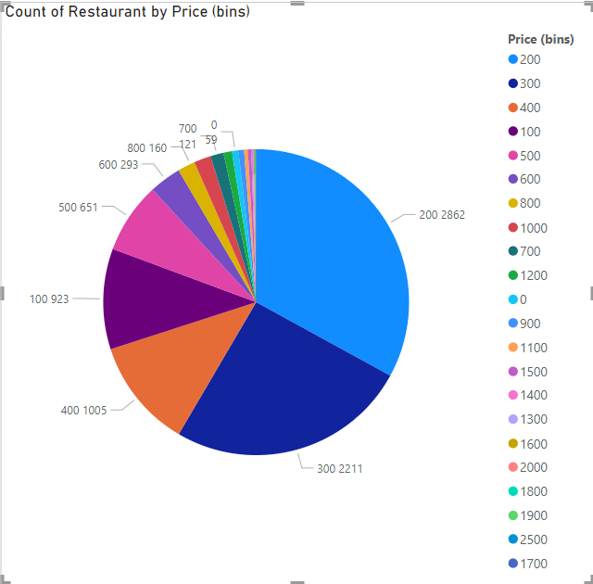
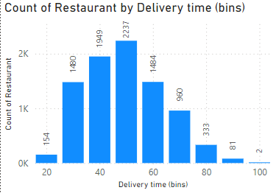
7. Price Analysis: Analyze the price distribution of restaurants.
8. Delivery Time Analysis: Analyze the average delivery time of restaurants.

Slide 7
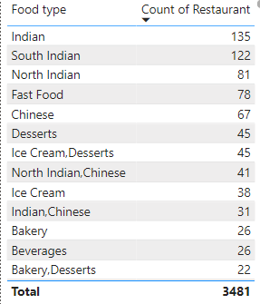
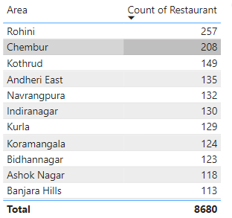
9. Cuisine Analysis: Analyze the variety of cuisines offered by restaurants.
10. Area-wise Restaurant Analysis: Analyze the number of restaurants in each area within the city.

Slide 8
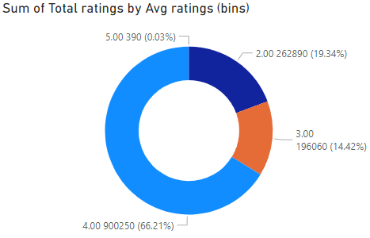
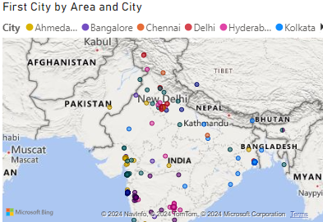
12. Customer Feedback Analysis: Analyze customer feedback based on ratings and total ratings.
13. Geographical Mapping: Create a geographical map of restaurant locations.

Slide 9
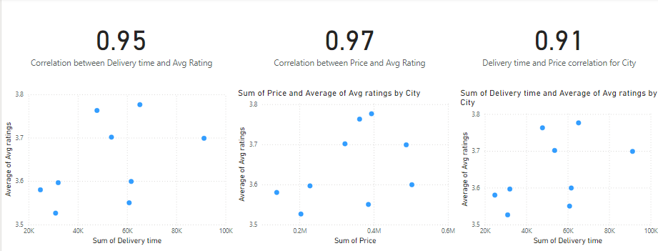
Correlation Analysis
0.95 (Delivery Time and Avg Rating): As delivery time increases, the average rating tends to increase significantly, or vice versa. This suggests that quicker delivery times are highly valued by customers, leading to higher ratings.
0.97 (Price and Avg Rating): Higher prices correlate strongly with higher average ratings. This indicates that higher-priced products are perceived as better quality, leading to higher ratings.
0.91 (Delivery Time and Price for City): There is a strong correlation between delivery time and price within the city context. This implies that more expensive products might have longer or shorter delivery times, depending on logistics and other factors.

Slide 10
Business Recommendations:
Enhance Delivery Efficiency:
Recommendation: Focus on reducing delivery times to improve average ratings.
Action Steps:
Optimize delivery routes using advanced logistics software.
Increase the number of delivery personnel, especially during peak hours.
Implement a real-time tracking system to monitor and manage deliveries more effectively.
Pricing Strategy:
Recommendation: Since price does not significantly correlate with average ratings, consider implementing flexible pricing strategies without fearing a negative impact on ratings.
Action Steps:
Test different pricing models, such as dynamic pricing based on demand or special offers during off-peak hours.
Conduct market research to understand the price sensitivity of different customer segments.
Focus on Quality and Speed:
Recommendation: Maintain high product quality and focus on faster delivery times to enhance customer satisfaction.
Action Steps:
Set strict quality control measures to ensure high standards are consistently met.
Gather customer feedback regularly and use it to make continuous improvements.
Provide training to vendors and delivery staff to maintain high service quality.

Slide 11
5.Operational Improvements:
1. Recommendation: Analyze and improve operational efficiencies, particularly focusing on delivery logistics.
2. Action Steps:
Use data analytics to identify bottlenecks in the delivery process and address them proactively.
Invest in technology to automate order processing and fulfillment to reduce delays.
Regularly review and optimize inventory management to ensure quick availability of products.
6. Marketing and Communication:
Recommendation: Use the insights from correlations to tailor marketing campaigns that highlight key strengths like fast delivery and high-quality products.
Action Steps:
Highlight fast delivery times and high customer ratings in marketing materials.
Use customer testimonials in promotions to build trust and attract new customers.
Segment the customer base and target specific demographics that value quick delivery and high-quality products.

